Slide 1



FLIGHT PRICE PREDICTION
KARTIK DHARI

Slide 2
INTRODUCTION
The objective of the study is to analyze the flight booking dataset obtained from “Ease My Trip” website and to conduct various statistical hypothesis tests in order to get meaningful insights from it. Ease My Trip is an internet platform for booking flight tickets. Study of the data will lead to the discovery of valuable insights that will be of enormous value to passengers.
The “Random Forest Regressor” algorithm would be used to train the dataset and predict a continuous target variable.

Slide 3
ABOUT THE DATASET
Dataset contains information about flight booking options between India's top 6 metro cities. There are 300153 data points and 12 features in the dataset.
The various features of the cleaned dataset are explained below:
1)Unnamed:0:Serial Number
2)Airline: The name of the airline company is stored in the airline column. It is a categorical feature having 6 different airlines.
3) Flight: Flight stores information regarding the plane's flight code. It is a categorical feature.
4) Source City: City from which the flight takes off. It is a categorical feature having 6 unique cities.

Slide 4
ABOUT THE DATASET
5) Departure Time: This is a derived categorical feature obtained created by grouping time periods into bins. It stores information about the departure time and have 6 unique time labels.
6) Stops: A categorical feature with 3 distinct values that stores the number of stops between the source and destination cities.
7) Arrival Time: This is a derived categorical feature created by grouping time intervals into bins. It has six distinct time labels and keeps information about the arrival time.
8) Destination City: City where the flight will land. It is a categorical feature having 6 unique cities.

Slide 5
ABOUT THE DATASET
9) Class: A categorical feature that contains information on seat class; it has two distinct values: Business and Economy.
10) Duration: A continuous feature that displays the overall amount of time it takes to travel between cities in hours.
11)Days Left: This is a derived characteristic that is calculated by subtracting the trip date by the booking date.
12) Price: Target variable stores information of the ticket price.

Slide 6
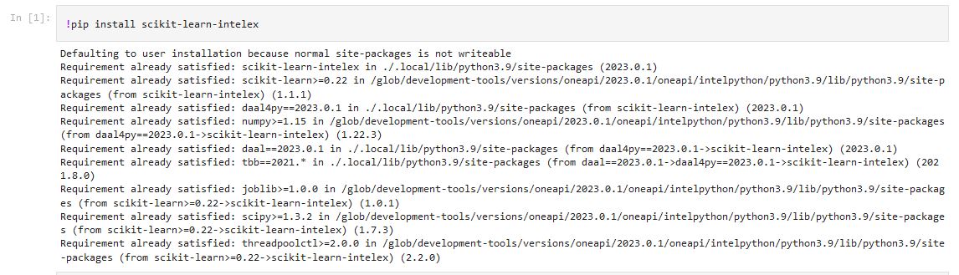
INVOKATION OF INTEL oneDAL

Slide 7
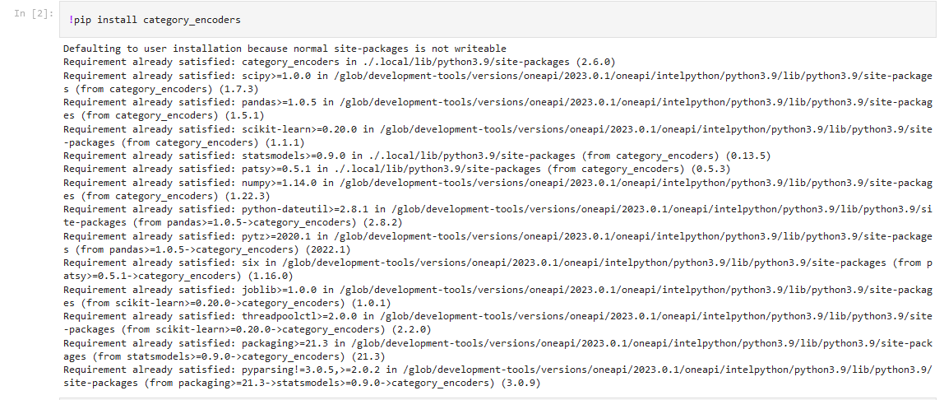
IMPORT LIBRARIES

Slide 8
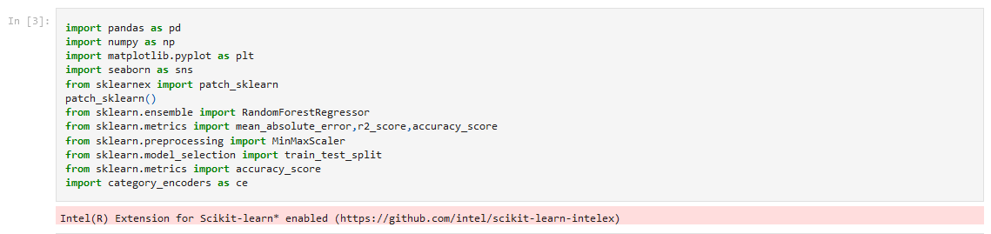
IMPORT LIBRARIES

Slide 9
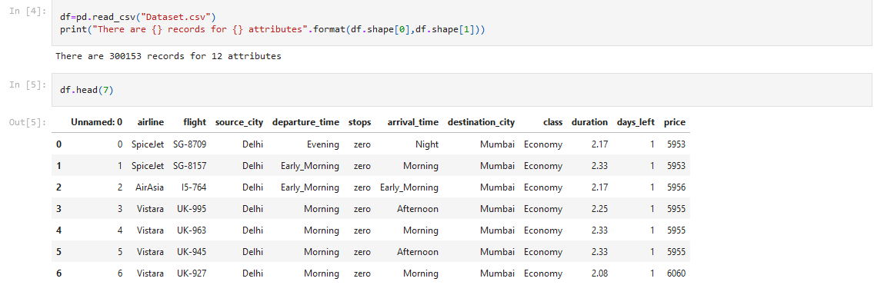
DIMENSIONAL ANALYSIS OF DATASET

Slide 10
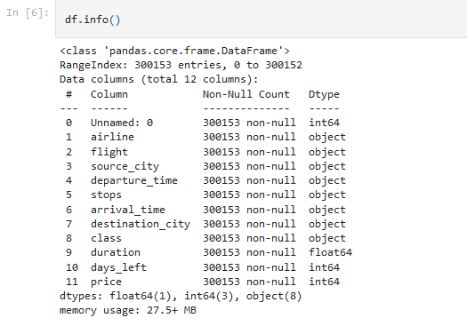
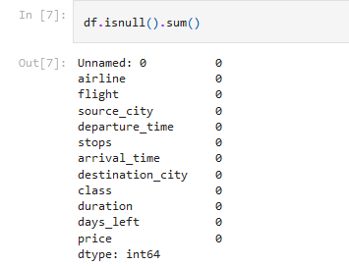
DIMENSIONAL ANALYSIS OF DATASET

Slide 11
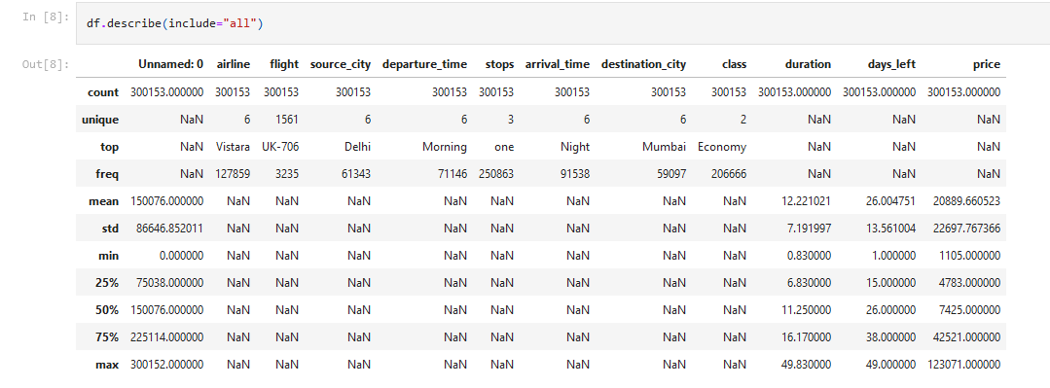
DIMENSIONAL ANALYSIS OF DATASET

Slide 12
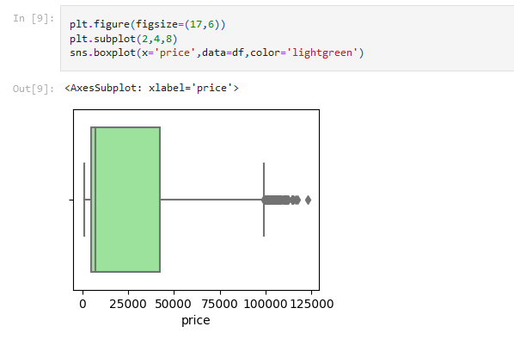
OUTLIER DETECTION WITH BOXPLOT

Slide 13
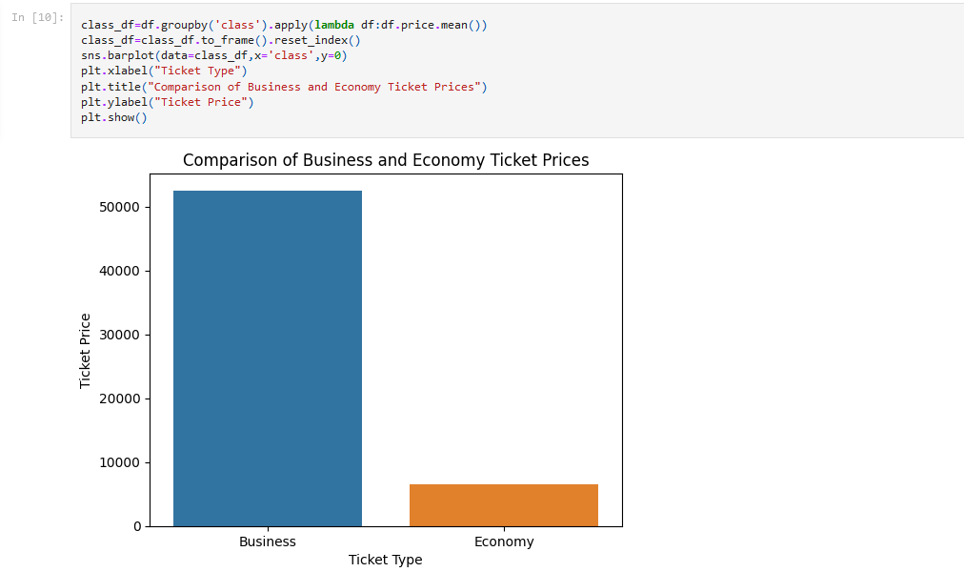
DATA VISUALIZATION

Slide 14
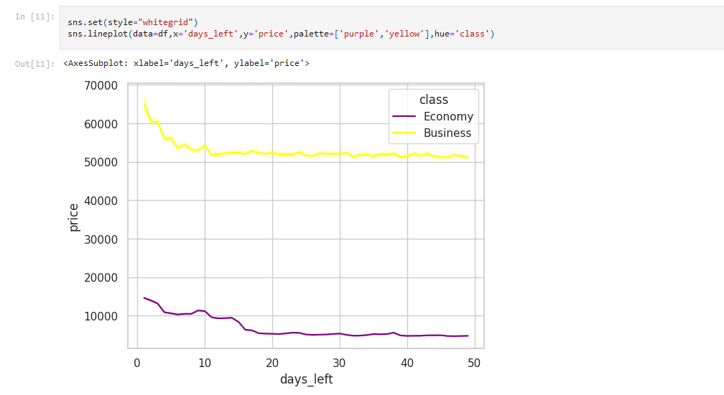
DATA VISUALIZATION

Slide 15
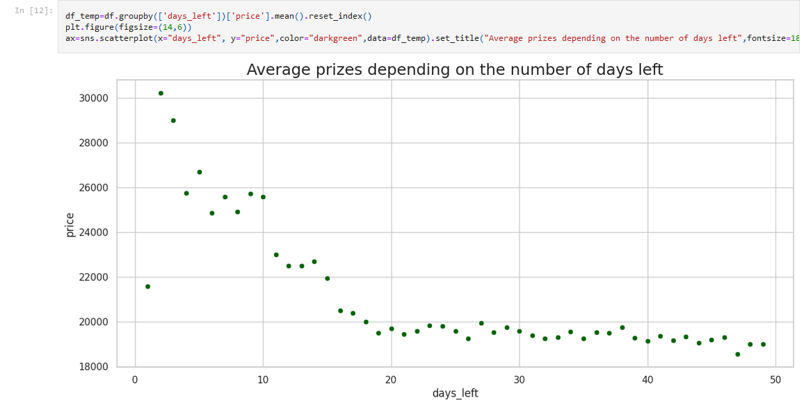
DATA VISUALIZATION

Slide 16
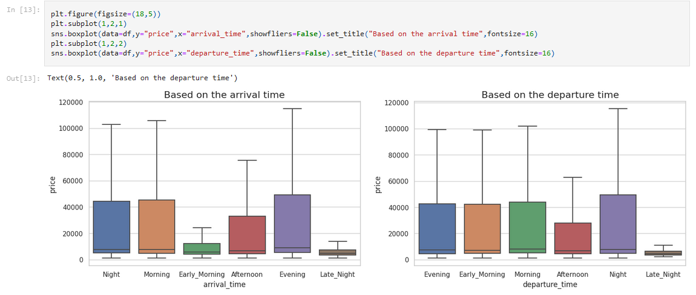
DATA VISUALIZATION

Slide 17
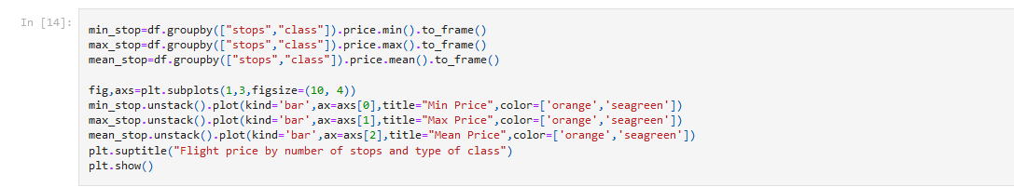
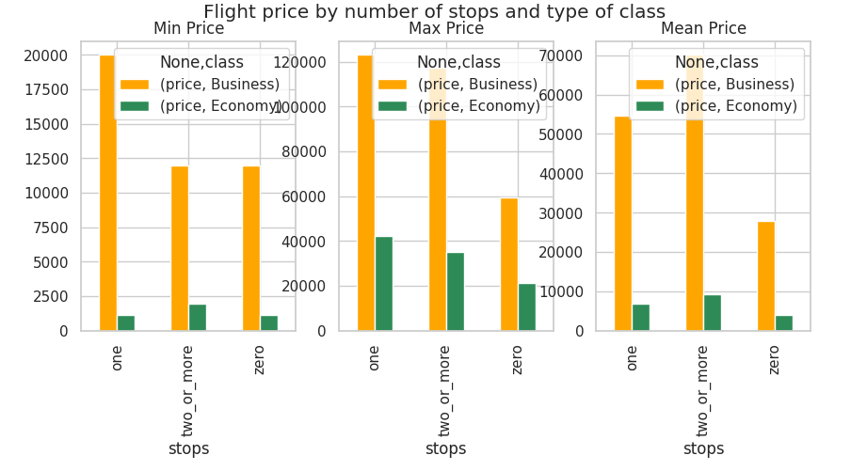
DATA VISUALIZATION

Slide 18
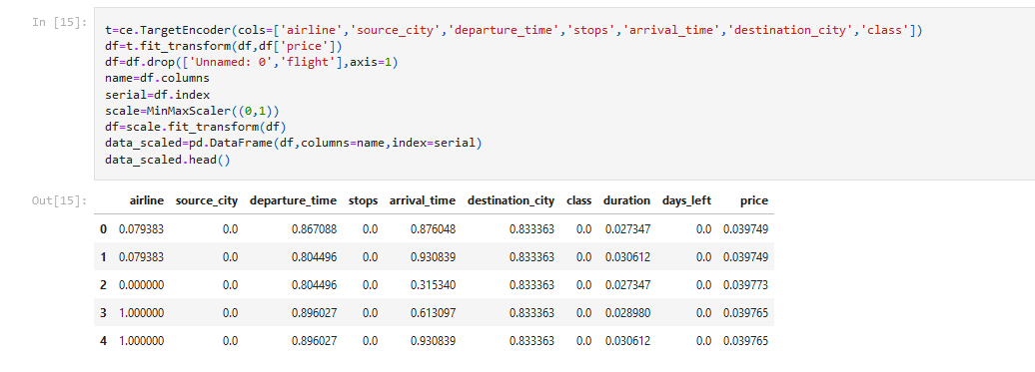
MODEL CREATION FOR PREDICTION

Slide 19

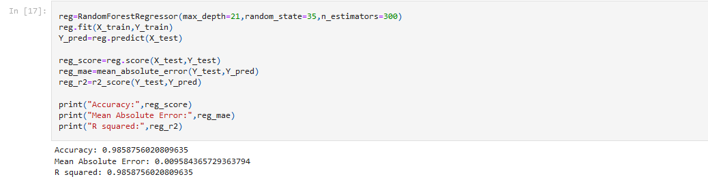
MODEL CREATION FOR PREDICTION

Slide 20
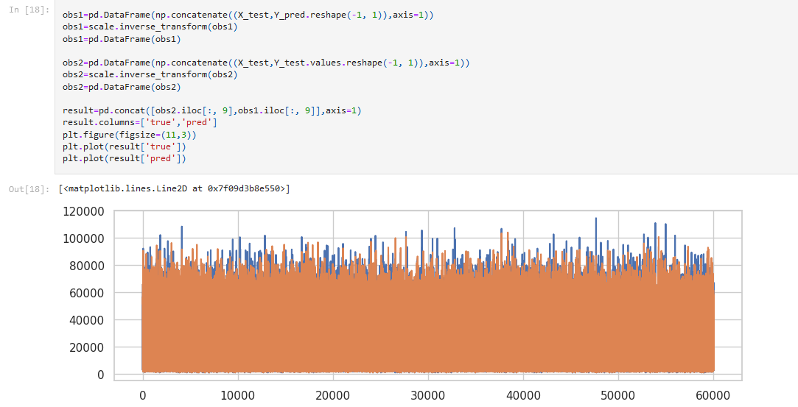
PREDICTION RESULT

Slide 21
CONCLUSION, REFERENCES & GITHUB LINK
Conclusion : Our model gives a plot between true and predicted data with an accuracy of 98.58%
Dataset Reference : https://www.kaggle.com/
GitHub Link : https://github.com/kartikdhari15/Intel-oneAPI.git

Slide 22
BUSINESS MODEL
There are more factors that determine the price of a flight. More and more features or attributes and variables can be added in the model in the future to gain more useful insights.
An application can be created to enable hassle free planning of travel.
Different factors that affect price of a flight may also reduce the travel cost for the customer.
In order to scale, along with the booking of flight tickets different segments like booking of bus, train and other modes of travel can be added.
Also reservations that are directly or indirectly related with the modes of travel can be incorporated.
Thus making the application or in a sense the business ‘Everything Under One Roof ‘.

